Slide 1
Face Recognition

Slide 2
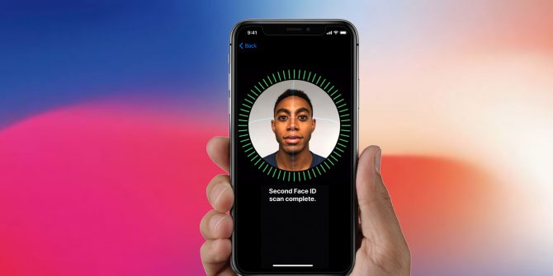

Slide 4
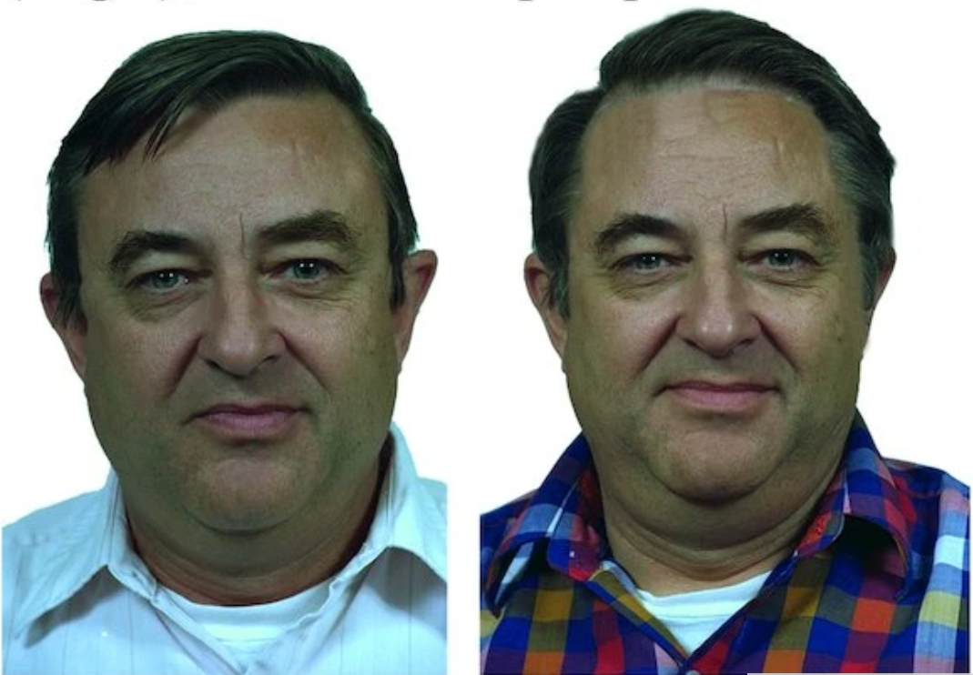

Slide 8
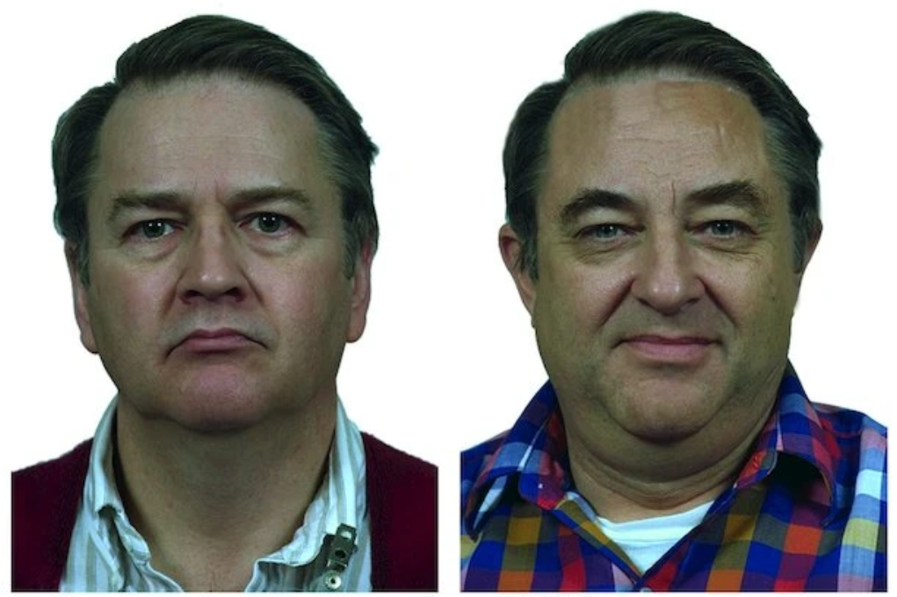

Slide 9
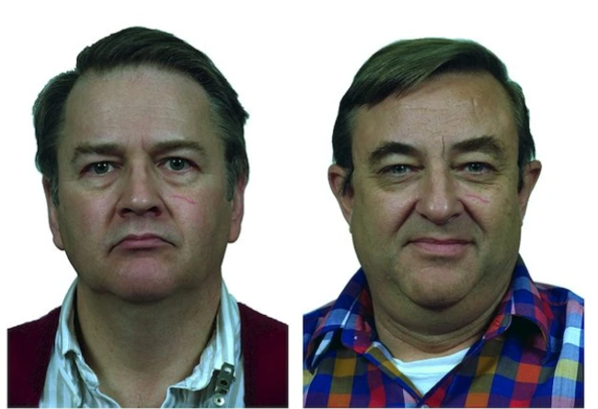

Slide 11
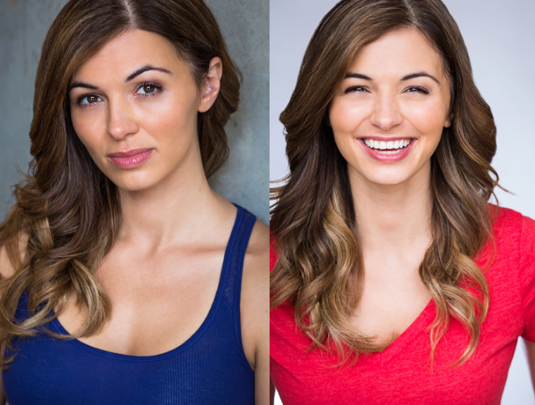

Slide 16
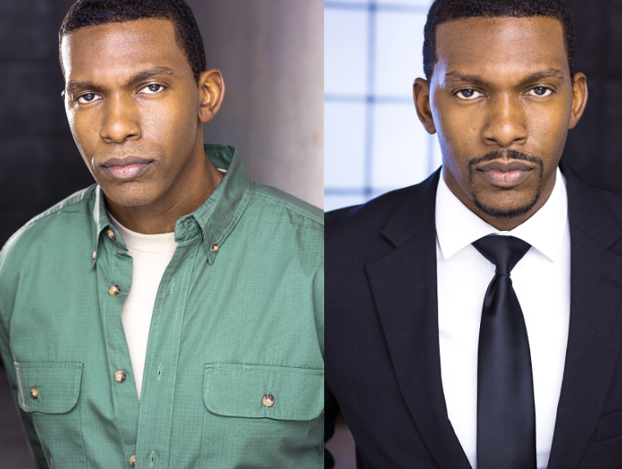

Slide 20
Case Study

Slide 21
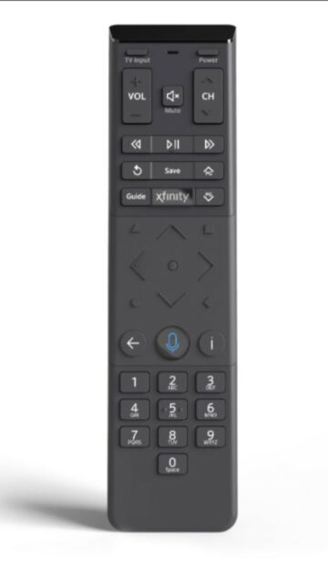
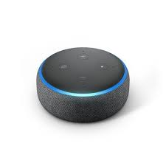
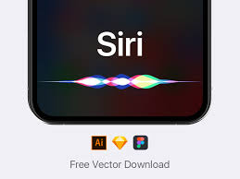

Slide 22
Activated by wake word

Slide 23
Activated by wake word
“Hey Siri, …”

Slide 24
Activated by wake word
“Hey Siri, …” → 0/1

Slide 25
2. Speech recognition

Slide 26
2. Speech recognition
“What is the weather tomorrow?”

Slide 27
2. Speech recognition
“What is the weather tomorrow?”
“Give me the sports scores.”

Slide 28
2. Speech recognition
“What is the weather tomorrow?”
“Give me the sports scores.”
“Call Mom.”

Slide 29
2. Speech recognition
Speech-to-text

Slide 30
3. Intent recognition

Slide 31
3. Intent recognition
Tell the time

Slide 32
3. Intent recognition
Tell the time
Play music

Slide 33
3. Intent recognition
Tell the time
Play music
Change the channel

Slide 34
3. Intent recognition
Tell the time
Play music
Change the channel
Make a call

Slide 35
3. Intent recognition
Input
“What time is it?”

Slide 36
3. Intent recognition
Input Intent
“What time is it?” → time

Slide 37
3. Intent recognition
Input Intent
“What time is it?” → time
“Tell me the time.” → time

Slide 38
3. Intent recognition
Input Intent
“What time is it?” → time
“Tell me the time.” → time
“How late is it?” → time

Slide 39
4. Intent execution

Slide 40
AI Pipeline

Slide 41
AI Pipeline
Wake word

Slide 42
AI Pipeline
Speech
recognition
Wake word
→

Slide 43
AI Pipeline
Speech
recognition
Intent
recognition
Wake word
→
→

Slide 44
AI Pipeline
Speech
recognition
Intent
recognition
Intent
execution
Wake word
→
→
→

Slide 45
Applications of AI

Slide 46
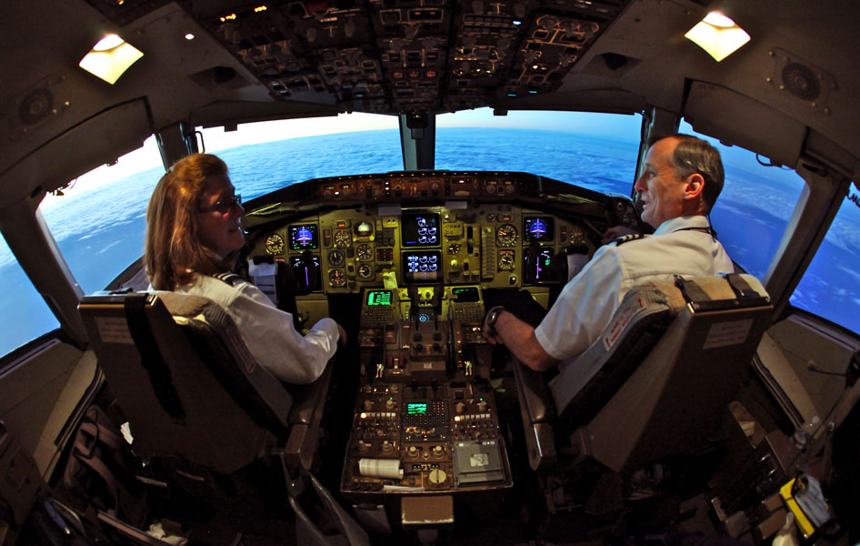
AI Autopilot

Slide 47
Agriculture

Slide 48
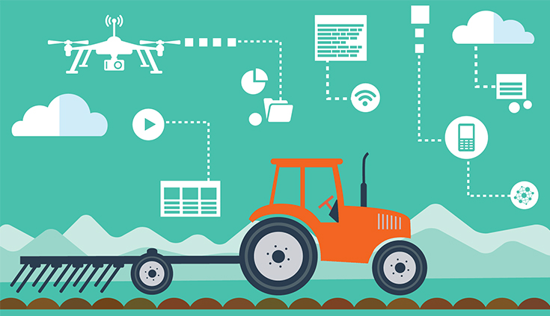
AgTech

Slide 49
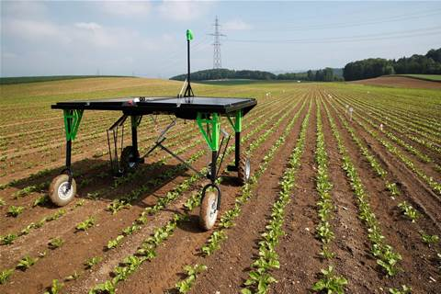

Slide 50
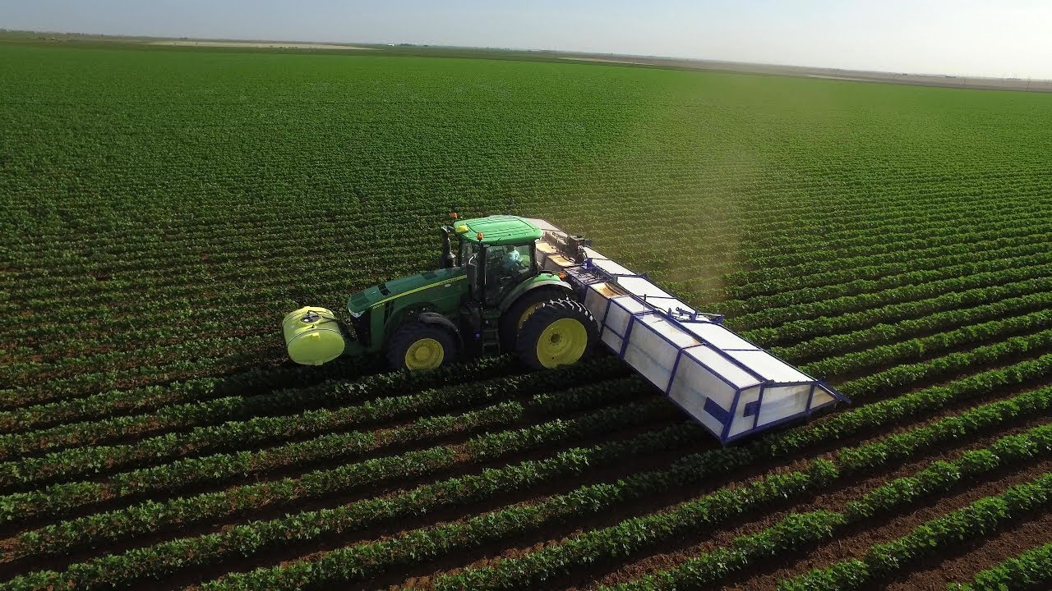

Slide 51
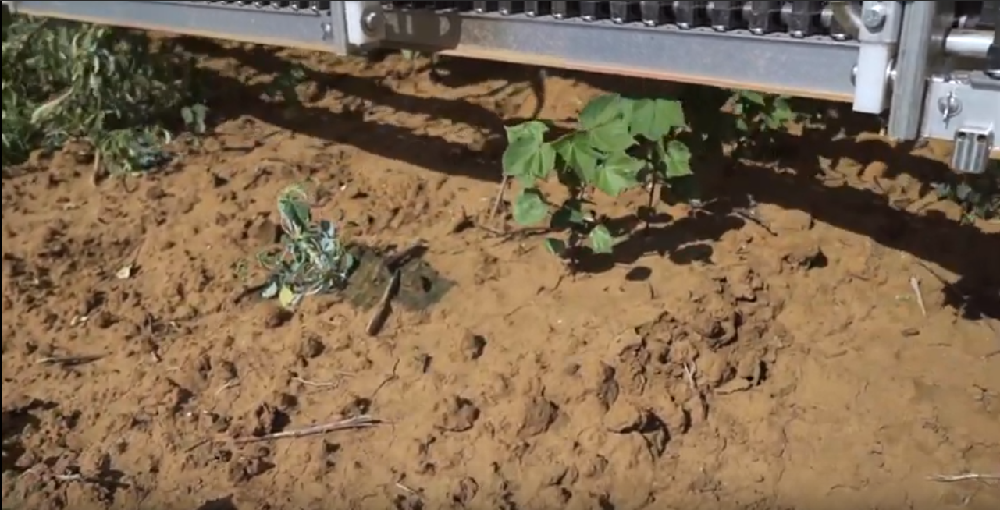

Slide 54
Fashion

Slide 55
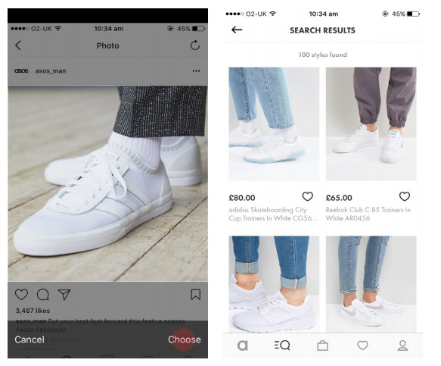
Visual Search

Slide 56

Visual Search

Slide 57
Face Recognition

Slide 58
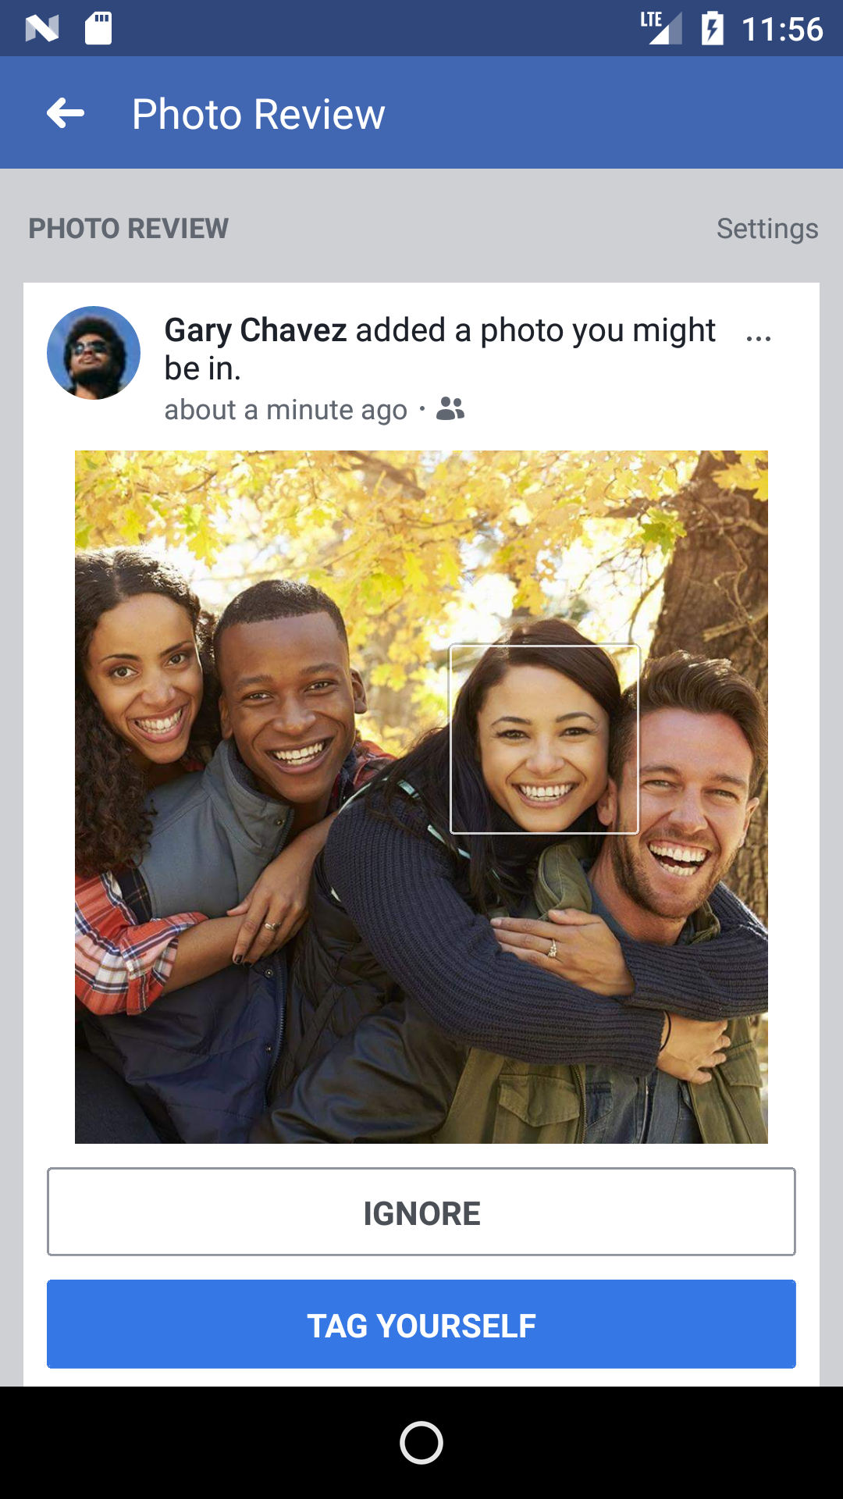

Slide 59
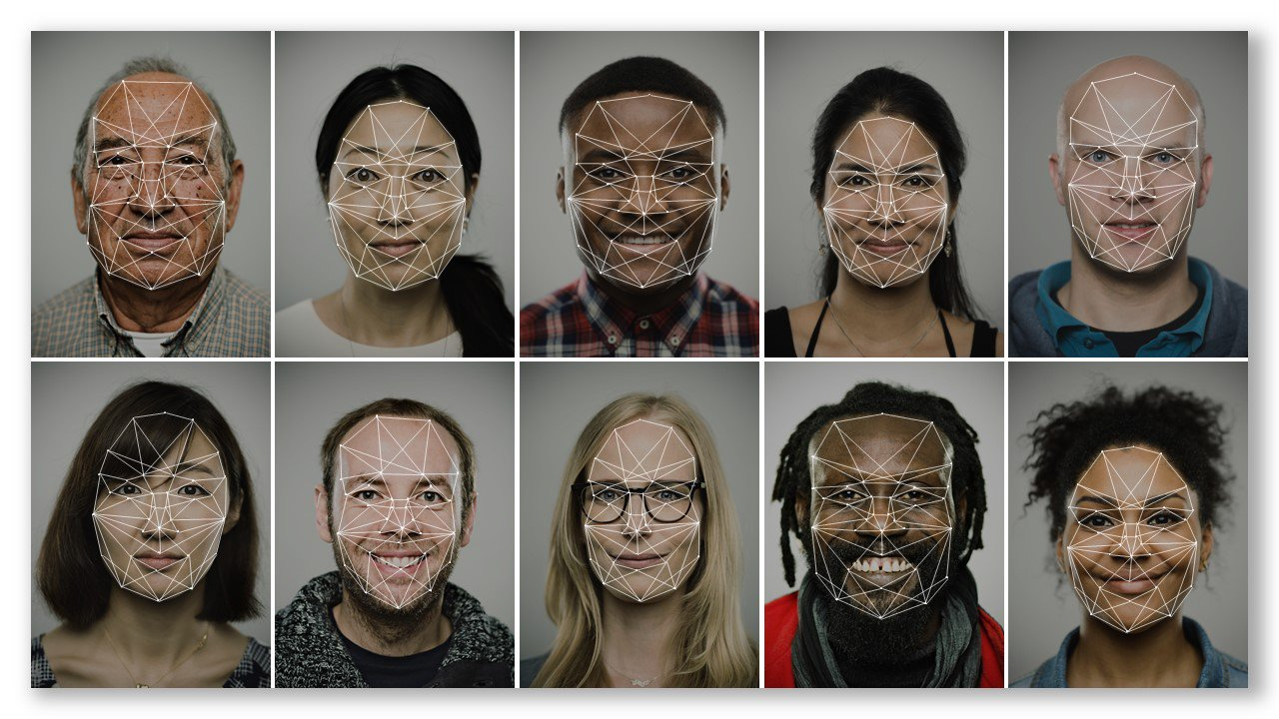

Slide 60
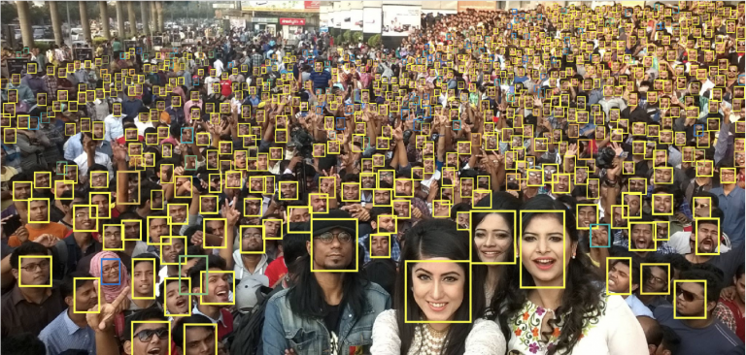

Slide 61
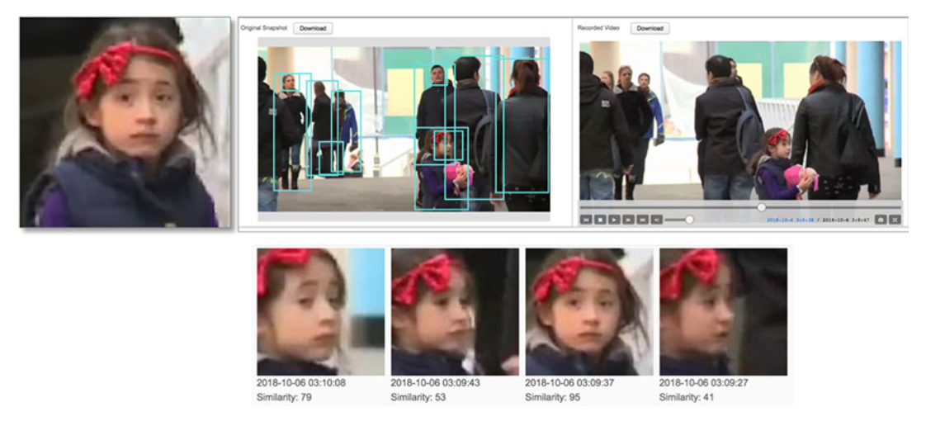
Face Search

Slide 62
What AI cannot do
(yet)

Slide 63
Ambiguity and Sublety

Slide 64
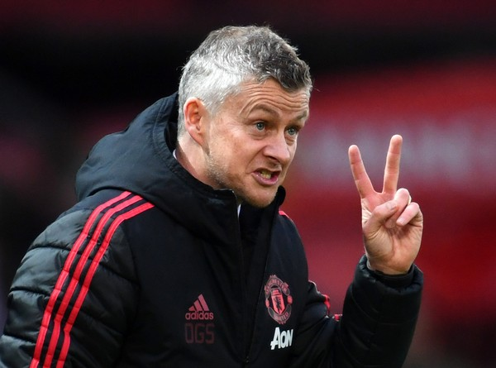

Slide 65

